Slide 1
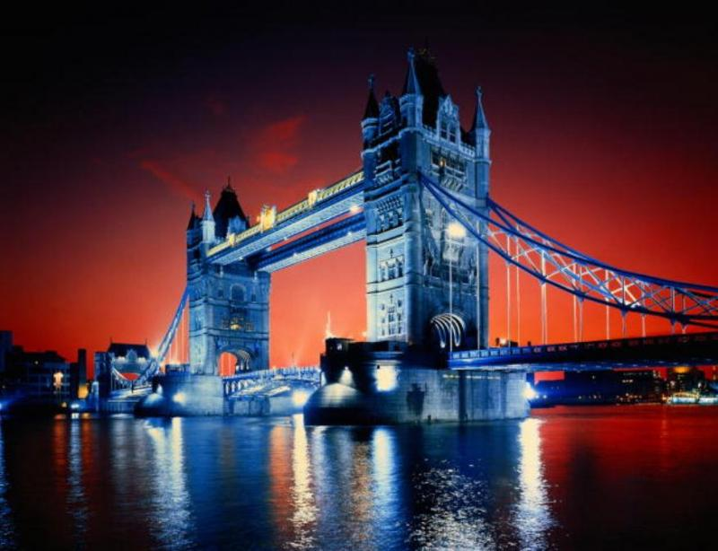
The Star Hour “Great Britain”
Титова Мария Васильевна
Учитель английского языка
МОУ«Кукуйская средняя общеобразовательная школа»
Веневского района Тульской области 16.05.2014 г.

Slide 2
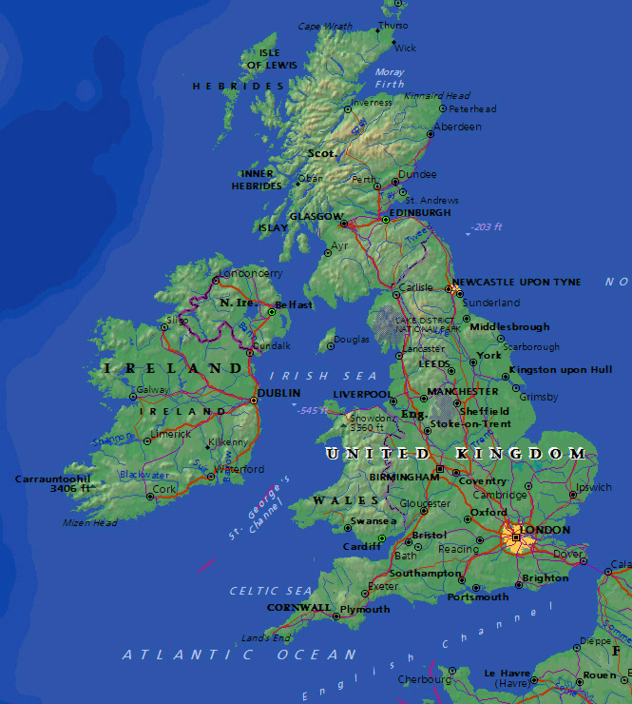
The United Kingdom of Great Britain and Northern Irelands is situated on the British Isles.
The British Isles consists of two large islands, Great Britain and Ireland, and about five thousand small islands.
Their total area is over 244,000 square kilometers.

Slide 3
Task 1. “Geography”.
You know some information about the UK. Look at the blackboard. You can see some figures and geographical names. Write six sentences down using the figures and geographical names.
1. Atlantic Ocean.
2. The Union Jack.
3. Four countries.
4. The Queen.
5. The Thames.
6. Edinburgh.

Slide 4
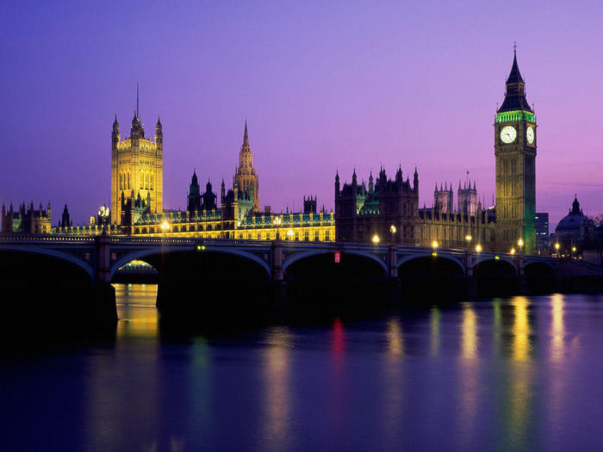
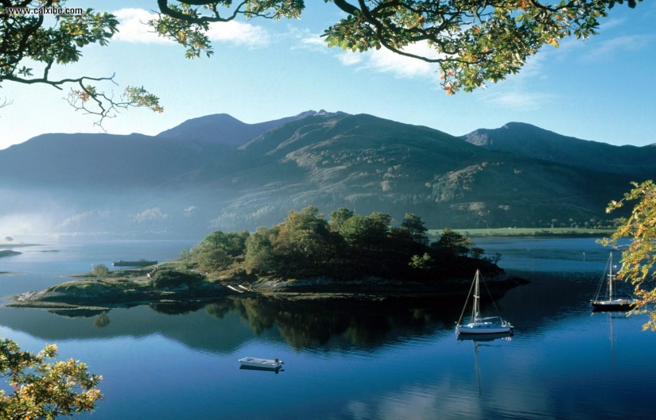
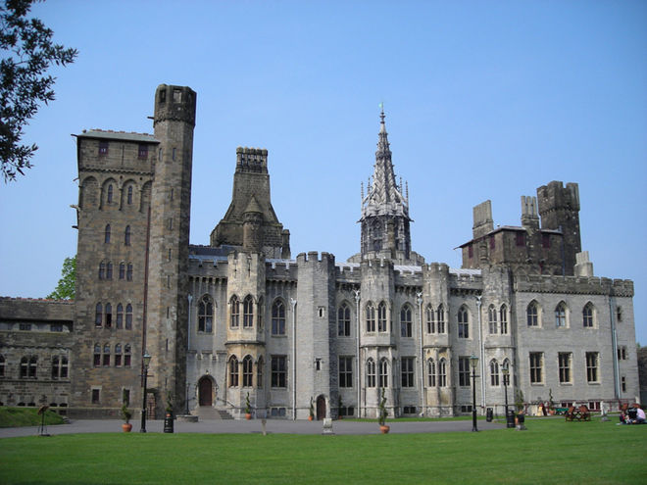
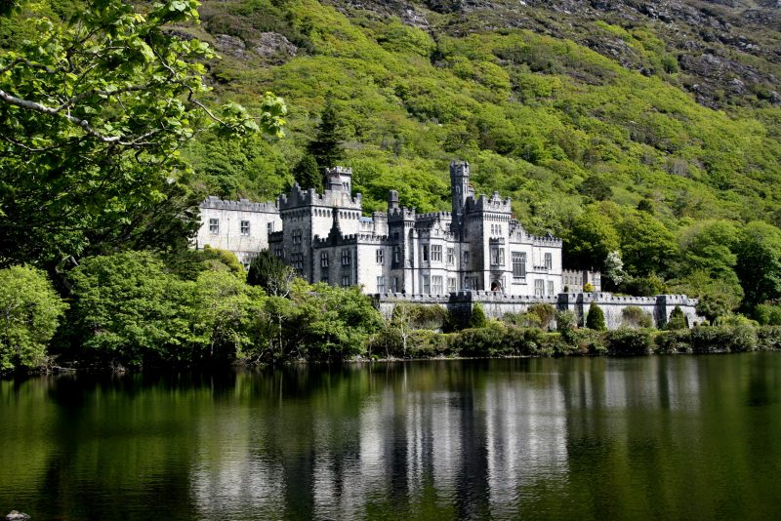
The UK is made up of four countries: England, Wales, Scotland and Northern Ireland. Great Britain consists of England, Scotland and Wales and doesn't include Northern Ireland.

Slide 5
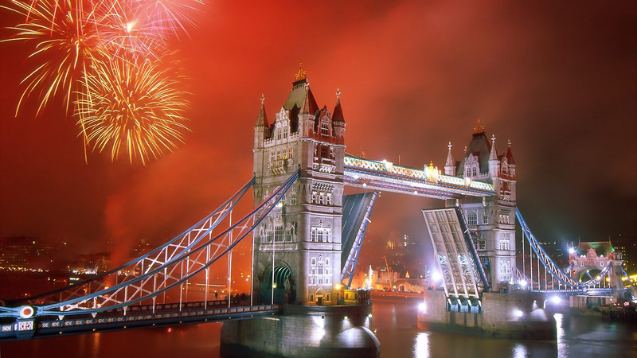
The capital of the UK is London.

Slide 6
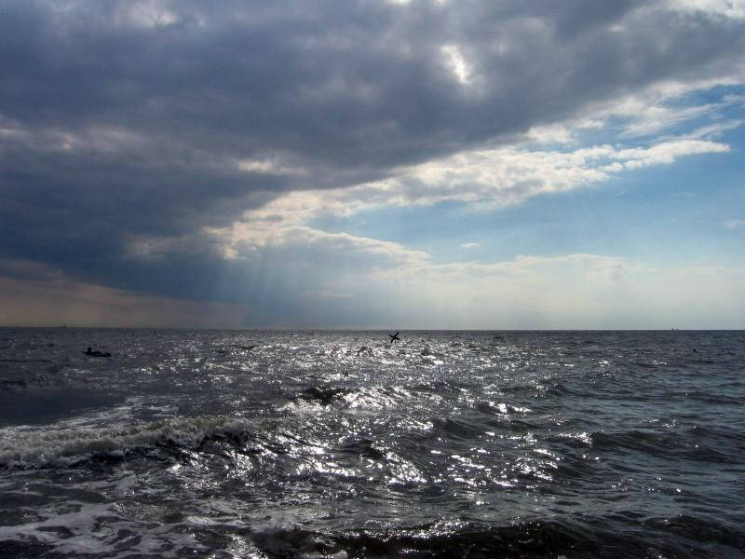
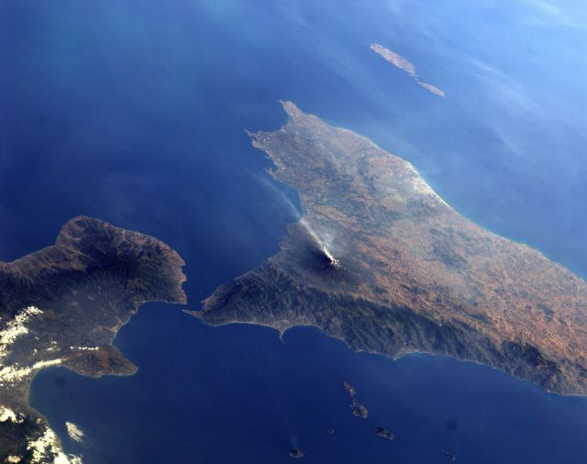
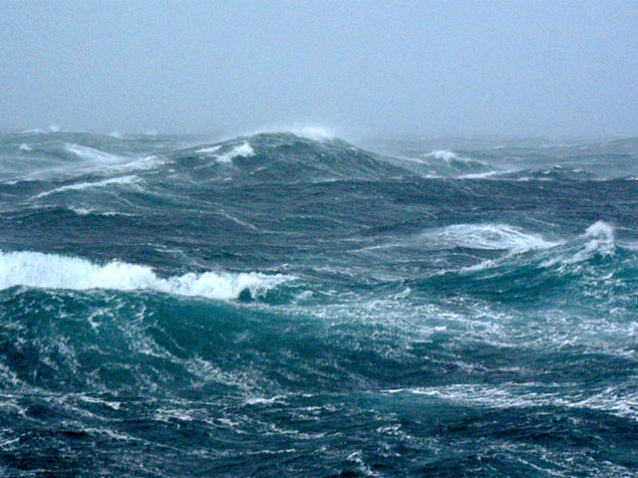
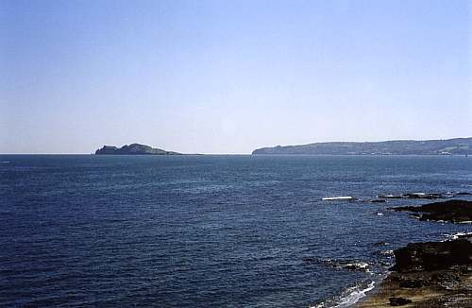
The British Isles are separated from European continent by the North Sea and the English Channel. The western coast of Great Britain is washed by the Atlantic Ocean and the Irish Sea.

Slide 7
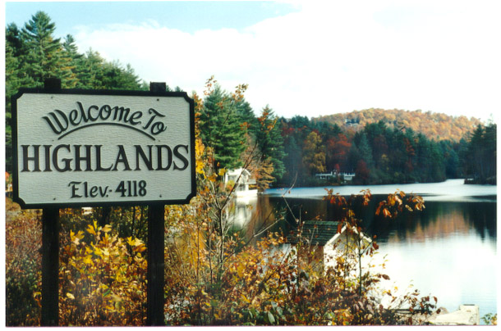
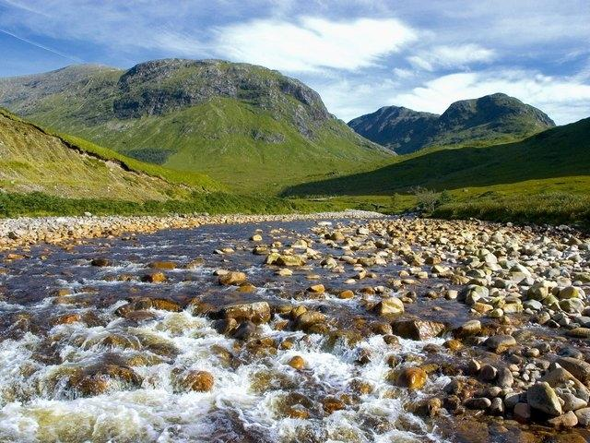
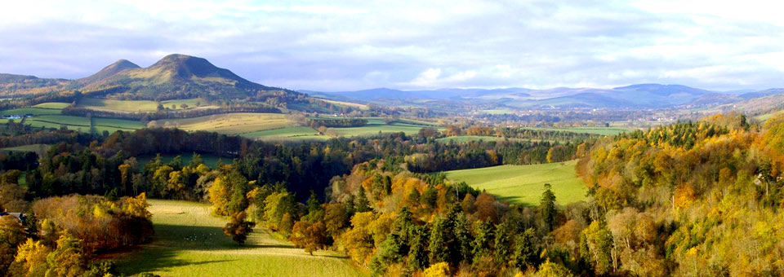
The surface of the British Isles varies very much. The north of Scotland is mountainous and is called the Highlands, while the south, which has beautiful valleys and plains, is called the Lowlands.

Slide 8
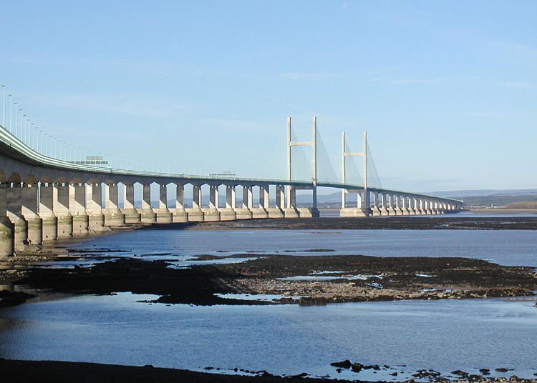
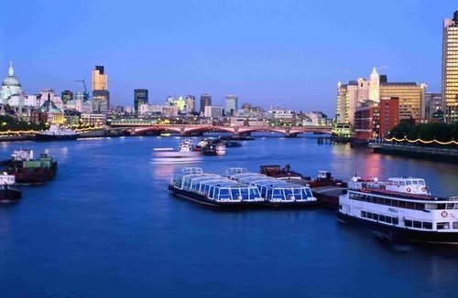
There are a lot of rivers in Great Britain, but they are not very long.
The Severn is the longest river,
while the Thames is the deepest and the most important one.

Slide 9
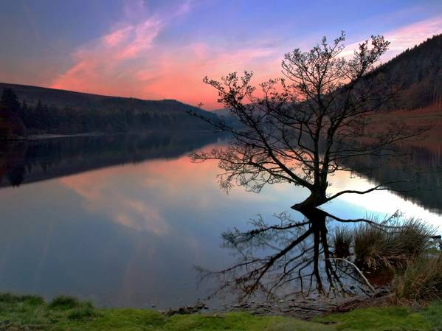
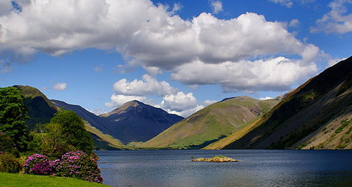
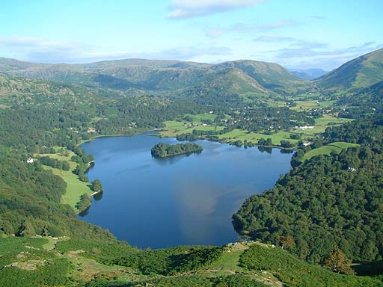
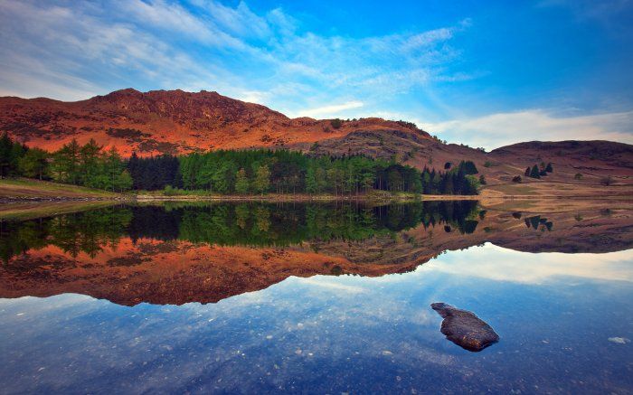
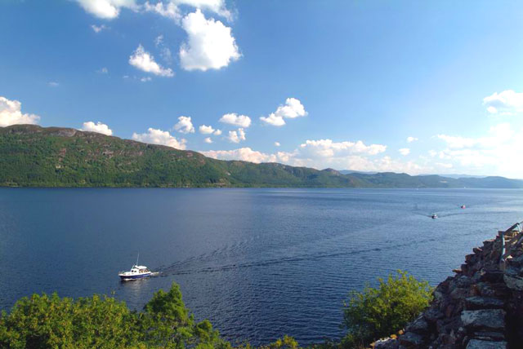
There are many lakes in Great Britain .

Slide 10
Task 2. “Holidays”.
There are a lot of holidays which are celebrated in the UK. You can see here six greeting cards. Listen to the small text and say what holiday it is about.
1. New Year Day.
2. Easter.
3. April Fool’s Day.
4. Christmas.
5. Halloween.
6. St Valentine’s Day.

Slide 14
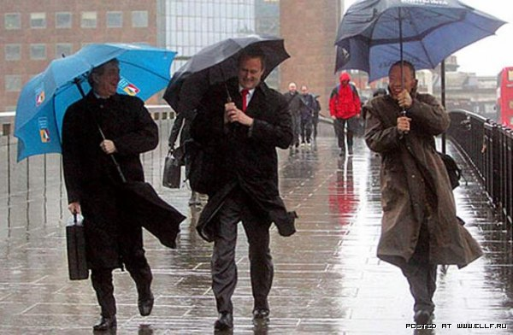
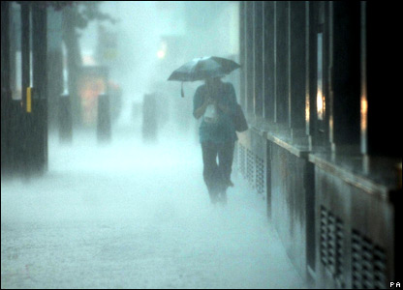
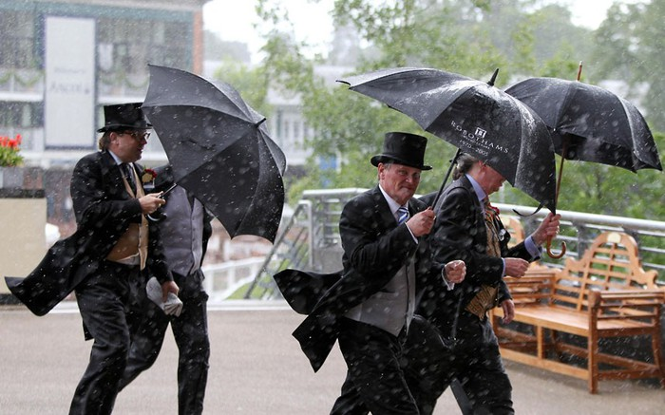
The weather in Great Britain is very changeable.
The English also say that they have three variants of weather:
when it rains in the morning, when it rains in the afternoon
or when it rains all day long.

Slide 15
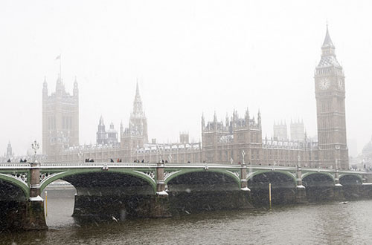
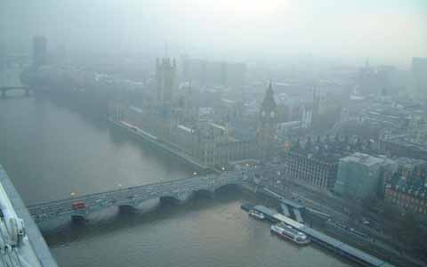
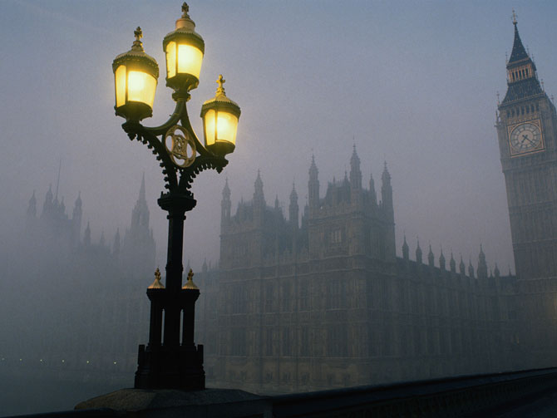
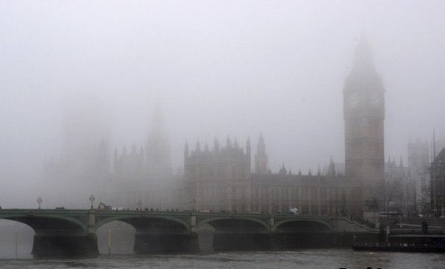
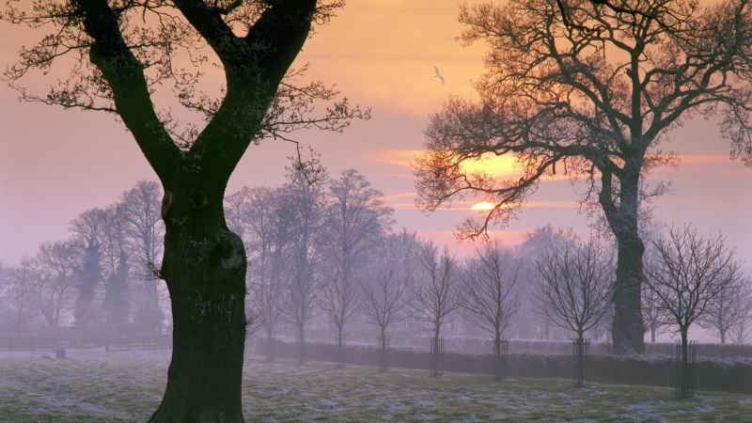
The most unpleasant aspect of English weather is fog and smog.

Slide 16
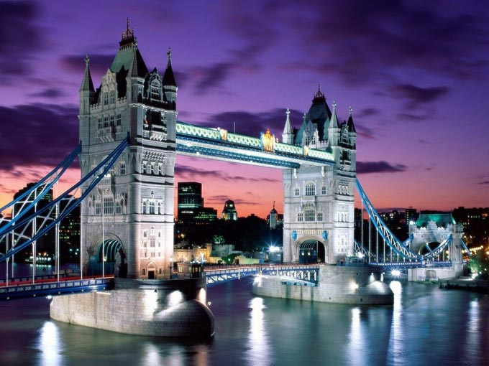
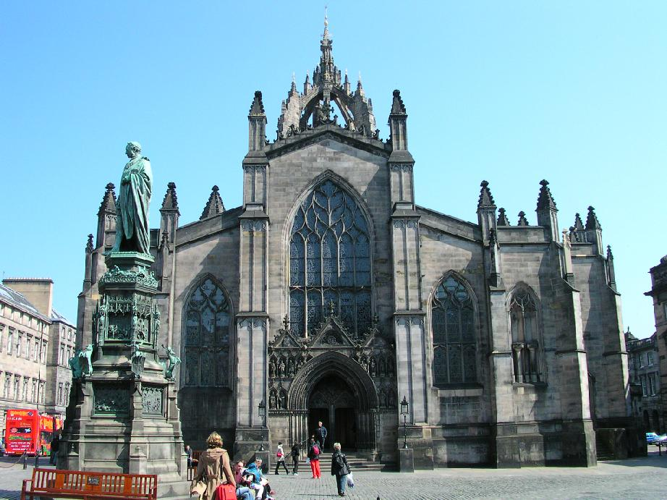
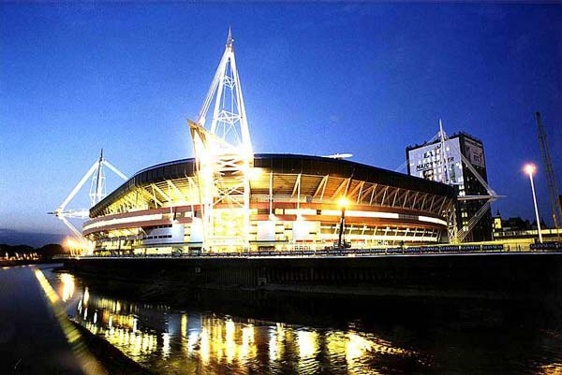
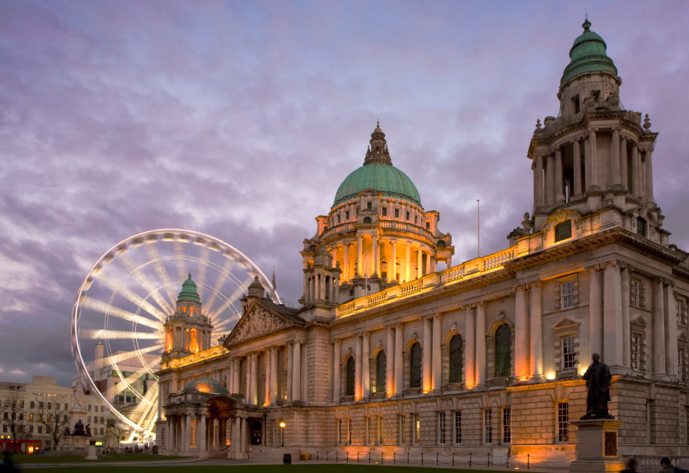
The capitals are: London in England , Edinburgh in Scotland , Cardiff in Wales and Belfast in Northern Ireland .

Slide 17
Task 3. “Dates”.
There are some well-known dates in the history of the UК. Do you know them? Look at the blackboard. You can see here some dates. Answer the questions.
1. 1666.
2. 1840.
3. 11th century.
4. 1703.
5. 1805.
6. 1980.

Slide 18
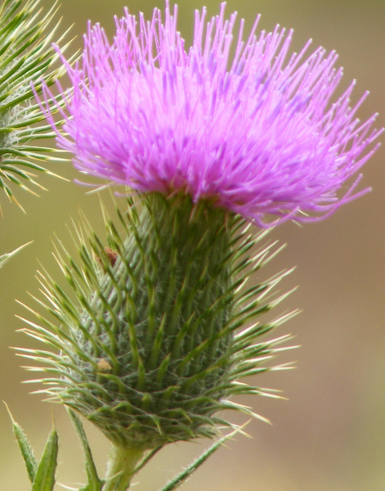
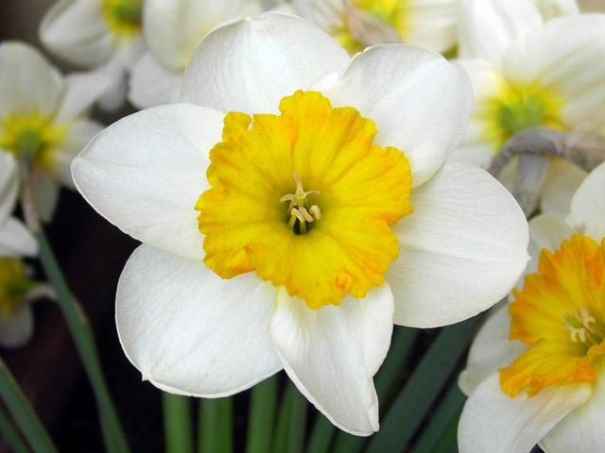
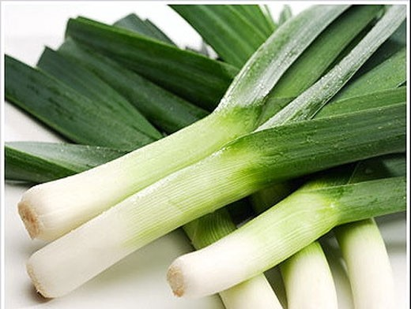
Every country has its own national emblem. The red rose is the national emblem of England. The thistle is the national emblem of Scotland. The daffodils and the leek are the emblems of Wales. The shamrock (a kind of clover) is the emblem of Ireland.

Slide 19
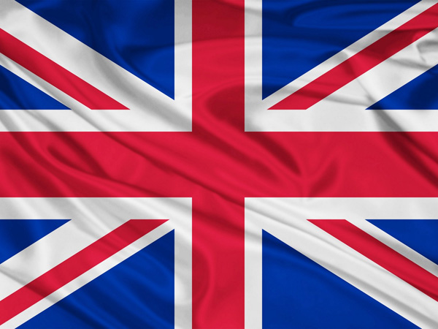
The flag of the UK is known as the Union Jack.The flag is made up of 3 crosses.
The upright cross is the Cross of St.George the patron saint of England . The white diagonal cross is the cross of St.Andrew, the patron saint of Scotland . The red diagonal cross is the cross is the cross of St.Patrick, the patron saint of Ireland . All of them are on the blue background.

Slide 20
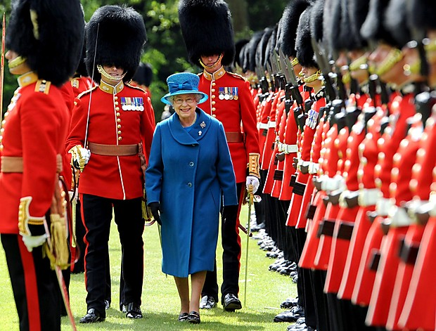
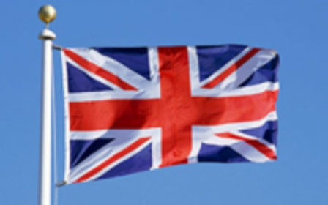
The national anthem is «God Save the Queen»
God save our gracious Queen, Long live our noble Queen, God save the Queen! Send her victorious, Happy and Glorious, Long to reign over us; God save the Queen!
O Lord our God arise, Scatter her enemies And make them fall; Confound their politics, Frustrate their knavish tricks, On Thee our hopes we fix, Oh, save us all!
Thy choicest gifts in store On her be pleased to pour; Long may she reign; May she defend our laws, And ever give us cause To sing with heart and voice, God save the Queen!
Not in this land alone, But be God's mercies known, From shore to shore! Lord make the nations see, That men should brothers be, And form one family, The wide world over
From every latent foe, From the assassins blow, God save the Queen! O'er her thine arm extend, For Britain's sake defend, Our mother, prince, and friend, God save the Queen!

Slide 21
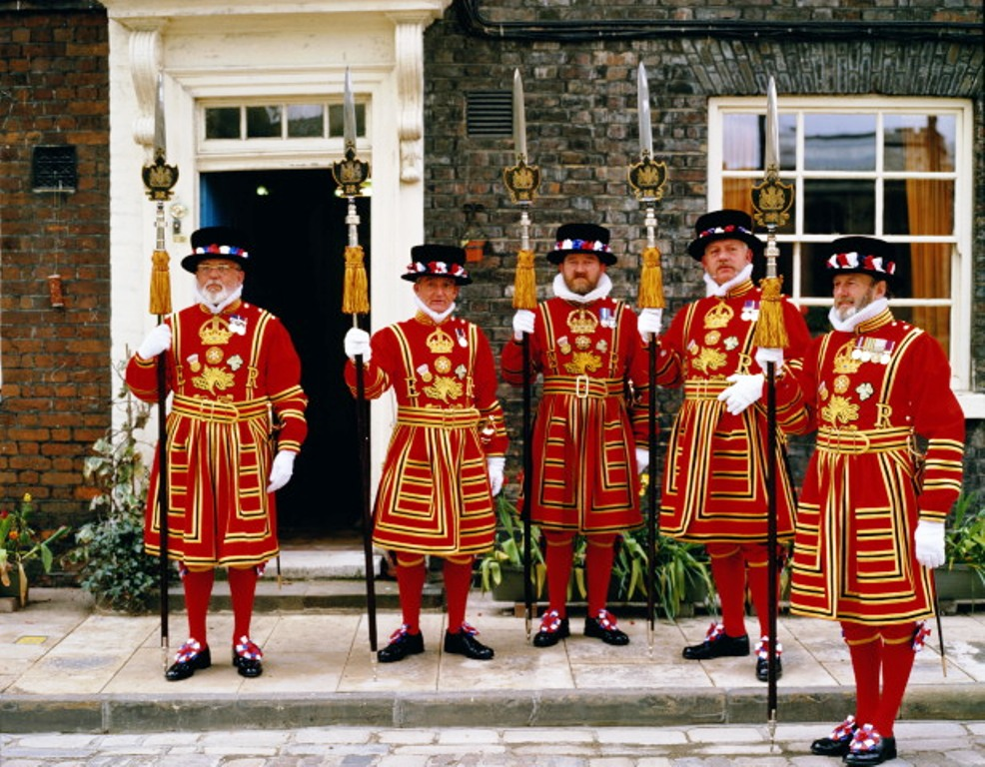
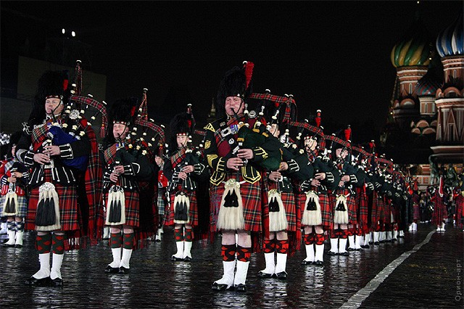
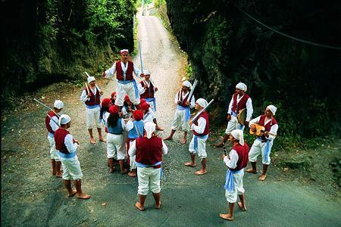
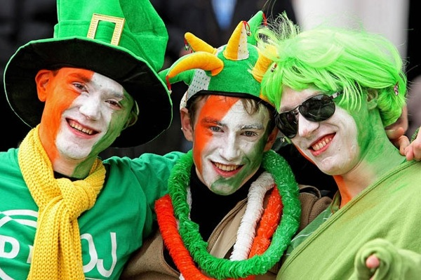
The population of the UK is over 58 mln people. The UK is inhabited by the English, the Scots, the Welsh and the Irish who constitute the British nation.

Slide 22
Task 4. “The famous people”.
You know a lot of famous British people. Can you guess who are they?
1. He was one of the most well known poets and playwrights of the world, born in the 16th century.
2. She was the only woman Prime Minister in the UK called “The Iron Lady”.
3. This monarch was married 6 times, his second daughter Elisabeth I became the queen known as the “Virgin Queen”.
4. This actress is known not only in Britain but all over the world thank to her roles as Cleopatra, Lady Hamilton and of course her Scarlet O’Hara from the screen version of “Gone with the Wind”.
5. He is a national Scottish poet. At midnight of December, 31st throughout GB people sing his “Auld Lang Syne”. Remember another poem.
My heart’s in the Highlands,
My heart is not here…
6. Her residence is in Buckingham Palace. British people love her very much.

Slide 23
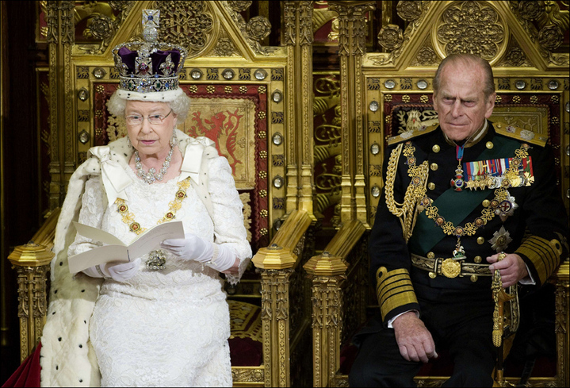
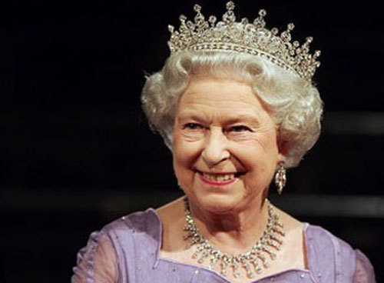
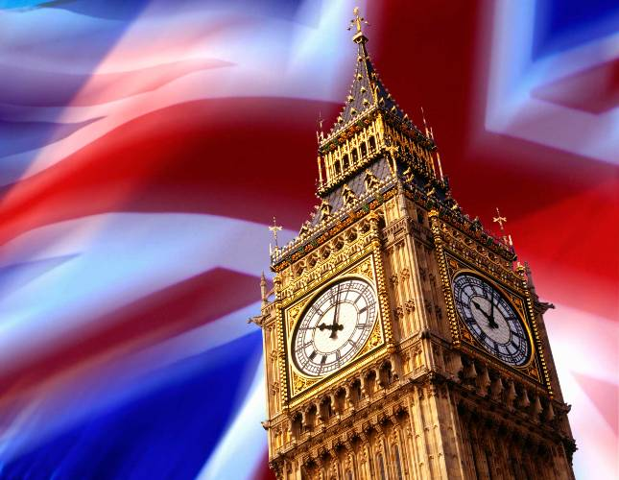
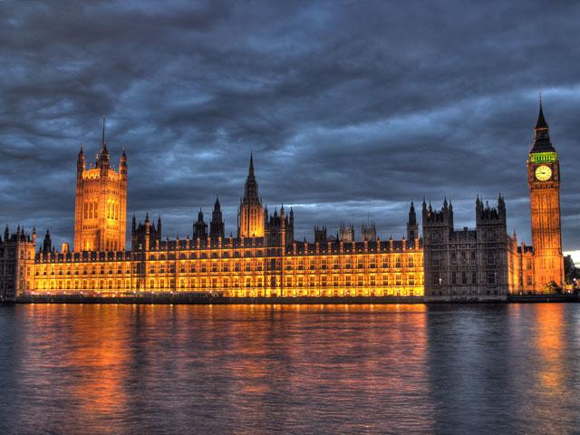
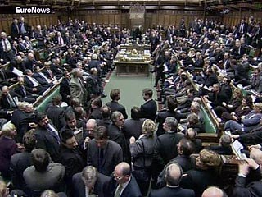
The UK is constitutional monarchy. In law, the Head of State is the Queen, but in practice, the Queen reigns, but does not rule. The country is ruled by the elected government with the Prime Minister at the head. The British Parliament consists of two chambers: the House of Lords and the House of Commons.

Slide 24
Task 5. “Sightseeing”.
There are a lot of interesting places in the United Kingdom. Look at the blackboard. Name the sightseeing and tell about it.
Участники игры рассказывают о достопримечательностях Британии.
1. Big Ben.
2. Tower Bridge.
3. St Paul’s Cathedral.
4. Westminster Abbey.
5. The National Gallery.
6. Trafalgar Square.

Slide 25
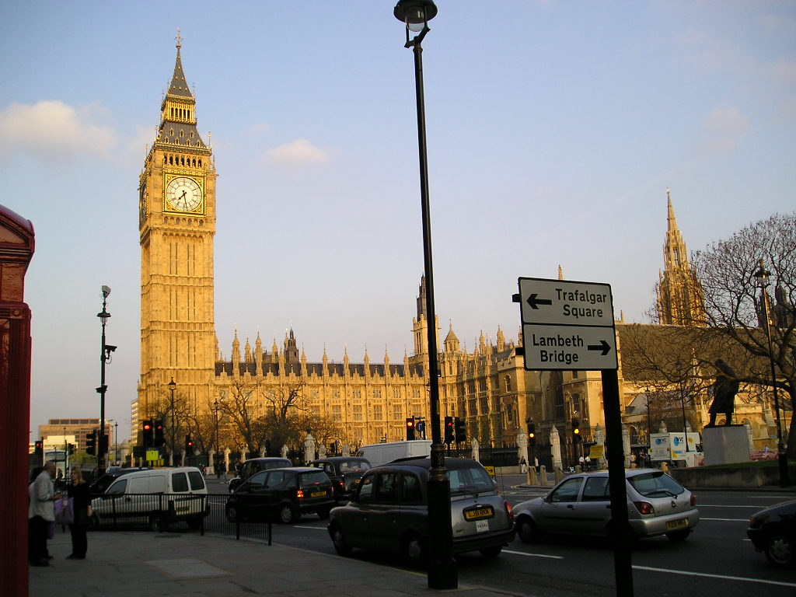

Slide 26
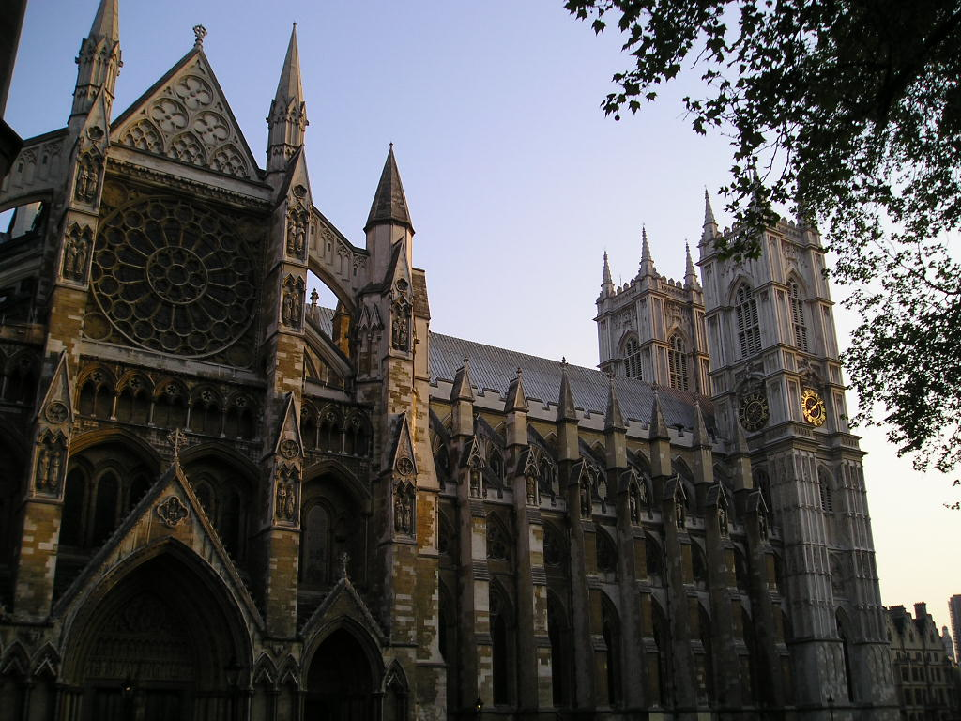

Slide 30
Блицтурнир.
1. What is the oldest part of London?
2. What event ended the plague in London in 1666?
3. What is one of the most ancient buildings of London, founded by William the Conqueror in the 11th century, used as a fortress, a palace, a prison and a royal treasury?
4. What is the address of the Prime Minister?
5. This church known in Russian as «западный монастырь», from its position 5 km west of London’s center, founded in the year 750 AD.
6. What is the queen of sports in Britain?
7. This game is played with an egg-shaped ball, which may be carried and thrown (but not forward). Each team has 15 players.
8. This game is very expensive. It needs large fields and good equipment. This is a popular meeting place of the business community.
9. This sport is big business. Every day of the year, except Sundays, there is a race meeting where many people make stakes on that who’ll win.
10. Who is the House of Commons presided over by?
11. What does Lord Chancellor sit on?
12. Which of the parties is nicknamed with a rude name for cattle-drivers? Name the party and its nickname.
13. How long has Elisabeth II ruled the UK?
14. Who was the longest ruling monarch of the UK?

Slide 31
Good luck!

Slide 32
Интернет ресурсы:
http://images.yandex.ru/yandsearch?text=великобритания&fp=0&pos=9&uinfo=ww-1252-wh-634-fw-1027-fh-448-pd-1&rpt=simage&img_url=http%3A%2F%2Fwww.alerce.ru%2Fimages%2Farticles%2Fart773_4b.jpg – Великобритания
2. http://images.yandex.ru/yandsearch?p=1&text=карта%20великобритания&fp=1&pos=41&uinfo=ww-1251-wh-634-fw-1026-fh-448-pd-1&rpt=simage&img_url=http%3A%2F%2Fwww.rupor.info%2Fmedia%2Farticle%2Fmain%2F2009-11%2F4kilo___________________________________________.jpg- карта Великобритании
3. http://images.yandex.ru/yandsearch?text=Англия&fp=0&pos=23&uinfo=ww-1251-wh-634-fw-1026-fh-448-pd-1&rpt=simage&img_url=http%3A%2F%2Fbyaki.net%2Fuploads%2Fposts%2F1175157018_0.jpg-Англия
4. http://images.yandex.ru/yandsearch?p=1&text=Уэльс&fp=1&pos=46&uinfo=ww-1251-wh-634-fw-1026-fh-448-pd-1&rpt=simage&img_url=http%3A%2F%2Fupload.wikimedia.org%2Fwikipedia%2Fcommons%2F5%2F5c%2FCardiff_Castle.JPG-Уэльс
5. http://images.yandex.ru/yandsearch?p=2&text=шотландия&fp=2&pos=70&uinfo=ww-1251-wh-634-fw-1026-fh-448-pd-1&rpt=simage&img_url=http%3A%2F%2Fwww.fotoart.org.ua%2Falbums%2Fuserpics%2Fscotland_4.jpg-Шотландия
6. http://images.yandex.ru/yandsearch?p=3&text=северная%20ирландия&fp=3&pos=108&uinfo=ww-1251-wh-634-fw-1026-fh-448-pd-1&rpt=simage&img_url=http%3A%2F%2Fimg-2006-06.photosight.ru%2F24%2F1503761.jpg-Северная Ирландия
7. http://images.yandex.ru/yandsearch?p=1&text=Лондон&fp=1&pos=59&uinfo=ww-1251-wh-634-fw-1026-fh-448-pd-1&rpt=simage&img_url=http%3A%2F%2Fi052.radikal.ru%2F0911%2F00%2Fa11d1bacb86d.jpg-Лондон
8. http://images.yandex.ru/yandsearch?text=северное%20море&fp=0&pos=1&uinfo=ww-1251-wh-634-fw-1026-fh-448-pd-1&rpt=simage&img_url=http%3A%2F%2Fi.piccy.kiev.ua%2Fi%2Ff5%2F69%2Fe39665e0f5c2e8ef3592d383795f.jpeg-Северное море
9. http://images.yandex.ru/yandsearch?p=2&text=English%20Channel&fp=2&pos=73&uinfo=ww-1251-wh-634-fw-1026-fh-448-pd-1&rpt=simage&img_url=http%3A%2F%2Fbigpicture.ru%2Fwp-content%2Fuploads%2F2011%2F09%2F536.jpg-English Channel
10. http://images.yandex.ru/yandsearch?text=Атлантический%20океан&fp=0&pos=0&uinfo=ww-1251-wh-634-fw-1026-fh-448-pd-1&rpt=simage&img_url=http%3A%2F%2Fimage.newsru.com%2Fpict%2Fid%2Flarge%2F1357260_20110315051537.gif-Атлантический Океан
11. http://images.yandex.ru/yandsearch?p=1&text=Irish%20Sea&fp=1&pos=43&uinfo=ww-1251-wh-634-fw-1026-fh-448-pd-1&rpt=simage&img_url=http%3A%2F%2Fsvit.ukrinform.ua%2FIrland%2Fimg%2Fshid2.jpg-Ирландское море
12. http://images.yandex.ru/yandsearch?text=the%20Highlands&fp=0&pos=0&uinfo=ww-1251-wh-634-fw-1026-fh-448-pd-1&rpt=simage&img_url=http%3A%2F%2Fhighlandsncrealestate.typepad.com%2Fhighlandsncrealestate%2Fimages%2Fhighlands.jpg-Высокогорье
13. http://images.yandex.ru/yandsearch?text=the%20Highlands&fp=0&pos=1&uinfo=ww-1251-wh-634-fw-1026-fh-448-pd-1&rpt=simage&img_url=http%3A%2F%2Fimg1.liveinternet.ru%2Fimages%2Fattach%2Fc%2F1%2F58%2F520%2F58520698_Nature_Scotland_112_Glen_Etive_Highlands.jpg-Высокогорье
14. http://images.yandex.ru/yandsearch?p=4&text=the%20Lowlands&fp=4&pos=147&uinfo=ww-1251-wh-634-fw-1026-fh-448-pd-1&rpt=simage&img_url=http%3A%2F%2Fwww.easyvoyage.co.uk%2Fimages%2Flieux%2F960x320%2F1212.jpg-Равнина
15. http://images.yandex.ru/yandsearch?p=1&text=the%20Lowlands&fp=1&pos=35&uinfo=ww-1251-wh-634-fw-1026-fh-448-pd-1&rpt=simage&img_url=http%3A%2F%2Fdiatrope.com%2FDB%2F5463.jpg-Равнина

Slide 33
Интернет ресурсы:
16. http://images.yandex.ru/yandsearch?text=Северн&fp=0&pos=1&uinfo=ww-1251-wh-634-fw-1026-fh-448-pd-1&rpt=simage&img_url=http%3A%2F%2Fupload.wikimedia.org%2Fwikipedia%2Fcommons%2F8%2F8b%2FNew_severn_bridge_best_750pix.jpg-Северн
17. http://images.yandex.ru/yandsearch?text=Темза&fp=0&pos=21&uinfo=ww-1251-wh-634-fw-1026-fh-448-pd-1&rpt=simage&img_url=http%3A%2F%2Fimg-fotki.yandex.ru%2Fget%2F4513%2Ffogel-alexa.29%2F0_4d354_937e92f_L-Темза
18. http://images.yandex.ru/yandsearch?text=озера%20в%20великобритании&fp=0&pos=3&uinfo=ww-1252-wh-634-fw-1027-fh-448-pd-1&rpt=simage&img_url=http%3A%2F%2Fwww.timetravel-britain.com%2Farticles%2F1photos%2Fcountry%2Flakes4.jpg-озера Великобритании
19. http://images.yandex.ru/yandsearch?text=озера%20в%20великобритании&fp=0&pos=8&uinfo=ww-1252-wh-634-fw-1027-fh-448-pd-1&rpt=simage&img_url=http%3A%2F%2Fwww.meridian-express.ru%2Fru%2Fimages%2Fpublic%2Fuk%2Fmini_sev1.jpg-озера Великобритании
20. http://images.yandex.ru/yandsearch?text=озера%20в%20великобритании&fp=0&pos=11&uinfo=ww-1252-wh-634-fw-1027-fh-448-pd-1&rpt=simage&img_url=http%3A%2F%2Fimg-fotki.yandex.ru%2Fget%2F4700%2F144866255.f%2F0_64ac8_4ecd8dae_XL-озера Великобритании
21. http://images.yandex.ru/yandsearch?text=озера%20в%20великобритании&fp=0&pos=15&uinfo=ww-1252-wh-634-fw-1027-fh-448-pd-1&rpt=simage&img_url=http%3A%2F%2Fi.allday.ru%2Fuploads%2Fposts%2F2008-10%2Fthumbs%2F1222868257_izmenenie-razmera-derwent-reservoir-derbyshire.jpg-озера Великобритании
22. http://images.yandex.ru/yandsearch?p=1&text=озера%20в%20великобритании&fp=1&pos=36&uinfo=ww-1252-wh-634-fw-1027-fh-448-pd-1&rpt=simage&img_url=http%3A%2F%2Ftourismnews.by%2Fcontent%2Fimages%2Fnews%2F2012%2F03%2F1%2Fazerni%2520kraj.jpg-озера Великобритании
23. http://images.yandex.ru/yandsearch?text=погода%20в%20великобритании&fp=0&pos=1&uinfo=ww-1252-wh-634-fw-1027-fh-448-pd-1&rpt=simage&img_url=http%3A%2F%2Fwww.1-property.ru%2Fimg%2Fnews%2Fb1710.jpg-погода
24. http://images.yandex.ru/yandsearch?p=1&text=погода%20в%20великобритании&fp=1&pos=34&uinfo=ww-1252-wh-634-fw-1027-fh-448-pd-1&rpt=simage&img_url=http%3A%2F%2Fimg.nr2.ru%2Fpict%2Farts1%2F32%2F87%2F328785.jpg-погода
25. http://images.yandex.ru/yandsearch?p=2&text=погода%20в%20великобритании&fp=2&pos=63&uinfo=ww-1252-wh-634-fw-1027-fh-448-pd-1&rpt=simage&img_url=http%3A%2F%2Fimg1.liveinternet.ru%2Fimages%2Fattach%2Fc%2F5%2F89%2F223%2F89223983_large_91211.jpg-погода

Slide 34
Интернет ресурсы:
26. http://images.yandex.ru/yandsearch?text=погода%20в%20великобритании&fp=0&pos=0&uinfo=ww-1252-wh-634-fw-1027-fh-448-pd-1&rpt=simage&img_url=http%3A%2F%2Fscienceblog.ru%2Fwp-content%2Fuploads%2F2009%2F06%2F117.jpg- погода
27. http://images.yandex.ru/yandsearch?text=погода%20в%20великобритании&fp=0&pos=0&uinfo=ww-1252-wh-634-fw-1027-fh-448-pd-1&rpt=simage&img_url=http%3A%2F%2Fscienceblog.ru%2Fwp-content%2Fuploads%2F2009%2F06%2F117.jpg-погода
28. http://images.yandex.ru/yandsearch?text=туман%20в%20великобритании&fp=0&pos=3&uinfo=ww-1252-wh-634-fw-1027-fh-448-pd-1&rpt=simage&img_url=http%3A%2F%2Fs48.radikal.ru%2Fi122%2F1104%2F05%2F6cfa6025a0c4.jpg-туман
29. http://images.yandex.ru/yandsearch?text=туман%20в%20великобритании&fp=0&pos=25&uinfo=ww-1252-wh-634-fw-1027-fh-448-pd-1&rpt=simage&img_url=http%3A%2F%2Fs7.7ba.ru%2Fex%2Fdl%2Fd2%2F7baRu_oboi-dlya-rabochego-stola---hd_598888.jpg-туман
30. http://images.yandex.ru/yandsearch?p=1&text=туман%20в%20великобритании&fp=1&pos=53&uinfo=ww-1252-wh-634-fw-1027-fh-448-pd-1&rpt=simage&img_url=http%3A%2F%2Fdelo.ua%2Ffiles%2Fnews_tape%2Fimages%2F1878%2F52%2Fvelikobritanija-kak-offsho_187852_s1.jpg-туман
31. http://images.yandex.ru/yandsearch?text=лондон&fp=0&pos=8&uinfo=ww-1252-wh-634-fw-1027-fh-448-pd-1&rpt=simage&img_url=http%3A%2F%2Fi265.photobucket.com%2Falbums%2Fii202%2Fkween8%2FDecorated%2520images%2FLondonEveningTowerBridgeEngland-1.jpg-Лондон
32. http://images.yandex.ru/yandsearch?p=1&text=эдинбург&fp=1&pos=37&uinfo=ww-1252-wh-677-fw-1027-fh-471-pd-1&rpt=simage&img_url=http%3A%2F%2Fwww.votpusk.ru%2Fgallery%2Flarge%2Fgb0166.jpg-Эдинбург
33. http://images.yandex.ru/yandsearch?p=2&text=кардифф&fp=2&pos=62&uinfo=ww-1252-wh-634-fw-1027-fh-448-pd-1&rpt=simage&img_url=http%3A%2F%2Fwww.coupedumonde2007.net%2Fimages%2Fstades%2Fmillenium.jpg-Кардифф
34. http://images.yandex.ru/yandsearch?p=1&text=белфаст&fp=1&pos=38&uinfo=ww-1252-wh-634-fw-1027-fh-448-pd-1&rpt=simage&img_url=http%3A%2F%2Fblu.stb.s-msn.com%2Fi%2F1E%2FEED2B3BFF76AB15BE33CD36F7B3A7.jpg-Белфаст
35. http://images.yandex.ru/yandsearch?text=эмблема%20англии&fp=0&pos=1&uinfo=ww-1252-wh-634-fw-1027-fh-448-pd-1&rpt=simage&img_url=http%3A%2F%2Fcs308722.vk.me%2Fg43737143%2Fa_2a7c975b.jpg-Эмблема Англии
36. http://images.yandex.ru/yandsearch?text=эмблема%20шотландии&fp=0&pos=2&uinfo=ww-1252-wh-634-fw-1027-fh-448-pd-1&rpt=simage&img_url=http%3A%2F%2Fupload.wikimedia.org%2Fwikipedia%2Fcommons%2F5%2F55%2FCirsium_vulgare_flowerhead_Anstey_Hill.PNG-чертополох
37. http://images.yandex.ru/yandsearch?text=нарцисс&fp=0&pos=8&uinfo=ww-1252-wh-634-fw-1027-fh-448-pd-1&rpt=simage&img_url=http%3A%2F%2Fimg1.liveinternet.ru%2Fimages%2Fattach%2Fc%2F0%2F51%2F633%2F51633339_1259169033_2e45996ad353.jpg-нарцисс

Slide 35
Интернет ресурсы:
38. http://images.yandex.ru/yandsearch?text=лук%20порей&fp=0&pos=4&uinfo=ww-1252-wh-634-fw-1027-fh-448-pd-1&rpt=simage&img_url=http%3A%2F%2Fimg1.liveinternet.ru%2Fimages%2Fattach%2Fc%2F5%2F88%2F971%2F88971577_large_LUKaa0.jpg-лук-порей
39. http://images.yandex.ru/yandsearch?text=эмблема%20ирландии&fp=0&pos=9&uinfo=ww-1252-wh-634-fw-1027-fh-448-pd-1&rpt=simage&img_url=http%3A%2F%2Fwww.phytology.ru%2Fimages%2Fstories%2FFloristika%2Fp665.jpg.jpg-эмблема Ирландии
40. http://images.yandex.ru/yandsearch?p=1&text=гимн%20великобритании&fp=1&pos=38&uinfo=ww-1252-wh-634-fw-1027-fh-448-pd-1&rpt=simage&img_url=http%3A%2F%2Fwww.mashreghnews.ir%2Ffiles%2Ffa%2Fnews%2F1391%2F5%2F23%2F199599_348.jpg-королева Великобритании
41. http://images.yandex.ru/yandsearch?text=флаг%20великобритании&fp=0&pos=20&uinfo=ww-1252-wh-634-fw-1027-fh-448-pd-1&rpt=simage&img_url=http%3A%2F%2Fwww.rusathletics.com%2Fimg%2Fimages%2Fnews%2F2011%2F12%2Fflag.jpg-флаг Великобритании
42.http://images.yandex.ru/yandsearch?text=%D0%B0%D0%BD%D0%B3%D0%BB%D0%B8%D1%87%D0%B0%D0%BD%D0%B5&img_url=http%3A%2F%2Fimg1.liveinternet.ru%2Fimages%2Fattach%2Fc%2F3%2F77%2F982%2F77982685_1315635320_article_imageimagearticle.jpg&pos=5&rpt=simage&lr=43&noreask=1&source=wiz&family=yes-англичане
43. http://images.yandex.ru/yandsearch?p=1&text=шотландцы&fp=1&pos=43&uinfo=ww-1252-wh-634-fw-1027-fh-448-pd-1&rpt=simage&img_url=http%3A%2F%2Fimg246.imageshack.us%2Fimg246%2F8766%2F57277827.jpg-шотландцы
44. http://images.yandex.ru/yandsearch?p=3&text=уэльсцы&fp=3&pos=107&uinfo=ww-1252-wh-634-fw-1027-fh-448-pd-1&rpt=simage&img_url=http%3A%2F%2Fitalia-ru.com%2Ffiles%2Fndrezzata.jpg-уэльсцы
45. http://images.yandex.ru/yandsearch?p=1&text=ирландцы&fp=1&pos=35&uinfo=ww-1252-wh-634-fw-1027-fh-448-pd-1&rpt=simage&img_url=http%3A%2F%2Fpics.nashgorod.ru%2Fimgfiles%2Fnewnews_imgs%2F2012%2F03%2F16%2F7ce3e69e110f72d2afac7e6c51385140.jpg-ирландцы
46. http://images.yandex.ru/yandsearch?text=конституционная%20монархия&fp=0&pos=1&uinfo=ww-1252-wh-634-fw-1027-fh-448-pd-1&rpt=simage&img_url=http%3A%2F%2Fgraphics8.nytimes.com%2Fpackages%2Fflash%2FLens%2F2010%2F05%2F20100525POD%2F20100525POD-Embed2008-350.jpg-королева
47. http://images.yandex.ru/yandsearch?text=королева%20великобритании&fp=0&pos=2&uinfo=ww-1252-wh-634-fw-1027-fh-448-pd-1&rpt=simage&img_url=http%3A%2F%2Fwww.novostimira.com.ua%2Fimages%2Fnews%2F1374124940_209.jpg-королева

Slide 36
Интернет ресурсы:
48. http://images.yandex.ru/yandsearch?text=британский%20парламент&fp=0&pos=3&uinfo=ww-1252-wh-634-fw-1027-fh-448-pd-1&rpt=simage&img_url=http%3A%2F%2Ffarm4.static.flickr.com%2F3218%2F2706292588_2e88889a4e_m.jpg-британский парламент
49. http://images.yandex.ru/yandsearch?text=британский%20парламент&fp=0&pos=10&uinfo=ww-1252-wh-634-fw-1027-fh-448-pd-1&rpt=simage&img_url=http%3A%2F%2Fimage.newsru.com%2Fpict%2Fid%2Flarge%2F1245423_20100204132303.gif-британский парламент
50. http://images.yandex.ru/yandsearch?text=британский%20парламент&fp=0&pos=21&uinfo=ww-1252-wh-634-fw-1027-fh-448-pd-1&rpt=simage&img_url=http%3A%2F%2Fimg.nr2.ru%2Fpict%2Farts1%2F36%2F91%2F369129.jpg-Биг Бэн

